Slide 2
Whole Class Pack Day 8
WALT: order numbers up to 1000

Slide 3
Diving into Mastery Guidance for Educators
Each activity sheet is split into three sections, diving, deeper and deepest, which are represented by the following icons:
These carefully designed activities take your children through a learning journey, initially ensuring they are fluent with the key concept being taught; then applying this to a range of reasoning and problem-solving activities.
These sheets might not necessarily be used in a linear way. Some children might begin at the ‘Deeper’ section and in fact, others may ‘dive straight in’ to the ‘Deepest’ section if they have already mastered the skill and are applying this to show their depth of understanding.
Diving
Deeper
Deepest

Slide 4
Aim
Solve number and practical problems involving these ideas.

Slide 5
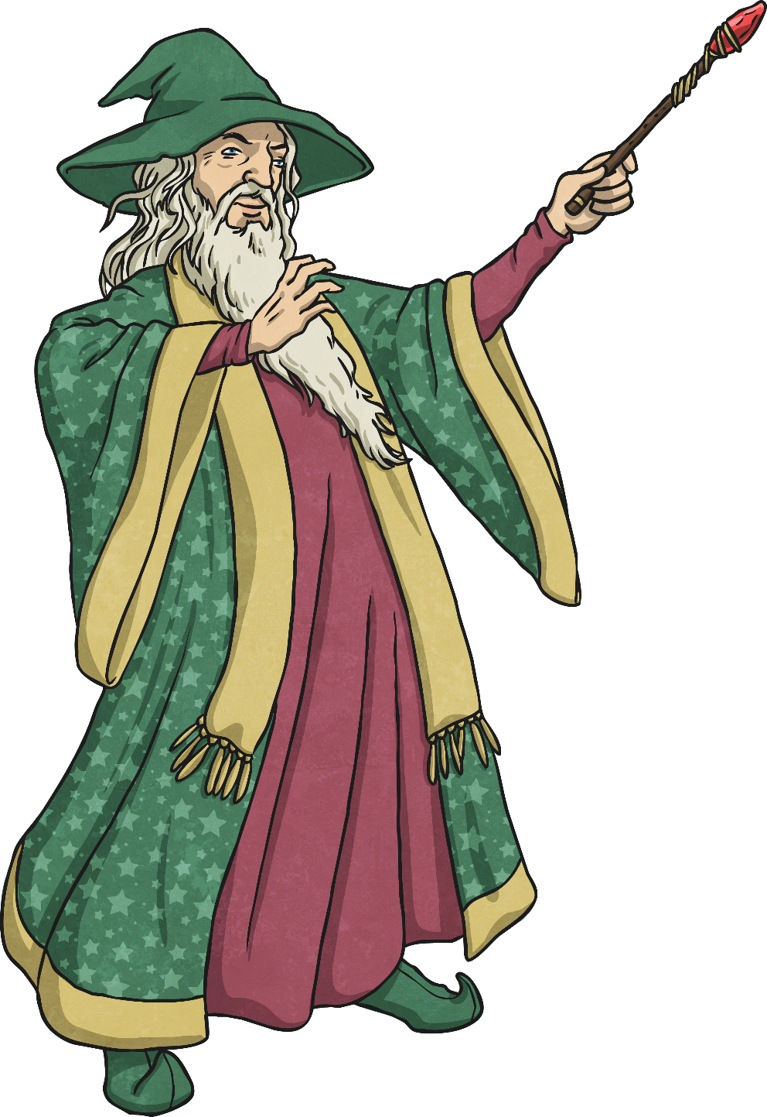
Compare Numbers to 1000
Diving
Which symbol would make this statement correct?
<, > or =
567 657
<

Slide 6
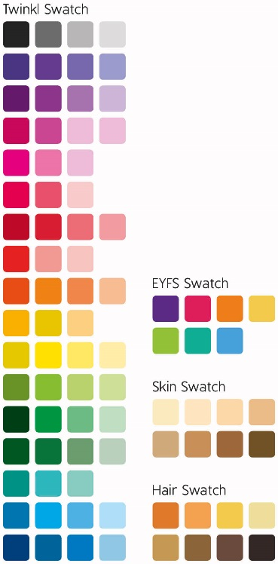
Compare Numbers to 1000
Diving
Which number is the smallest?
three hundred and forty-seven
374
700+ 30+ 4
four hundreds, three tens and seven ones
43 tens and 7 ones
743

Slide 7
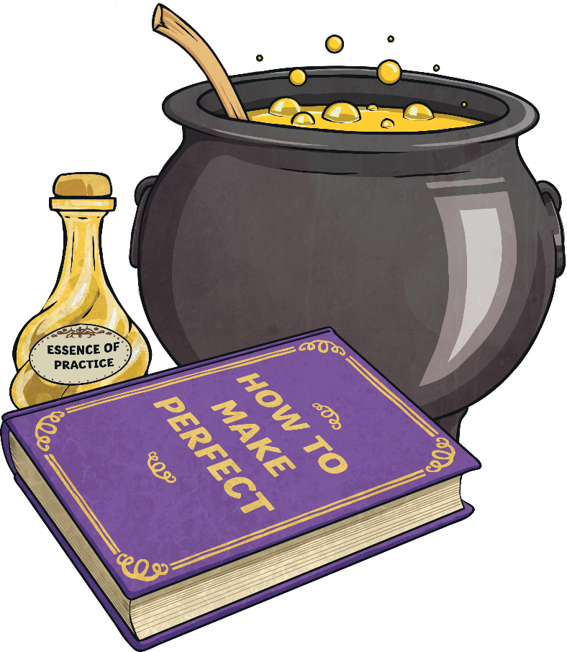
Compare Numbers to 1000
Deeper
653ml of swamp water is not enough to complete Wizard Walter’s potion, but 672ml is too much.
How much could the correct amount be?
654ml – 671ml

Slide 8
Compare Numbers to 1000
Deeper
How could we change this statement to be correct?
=
<
Four hundred and sixty one 46 tens and 1 one
Can you think of another way that we could change it to be correct?

Slide 9
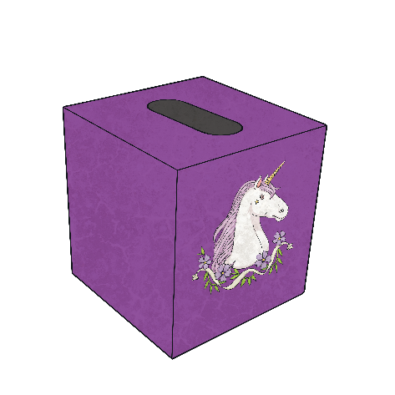
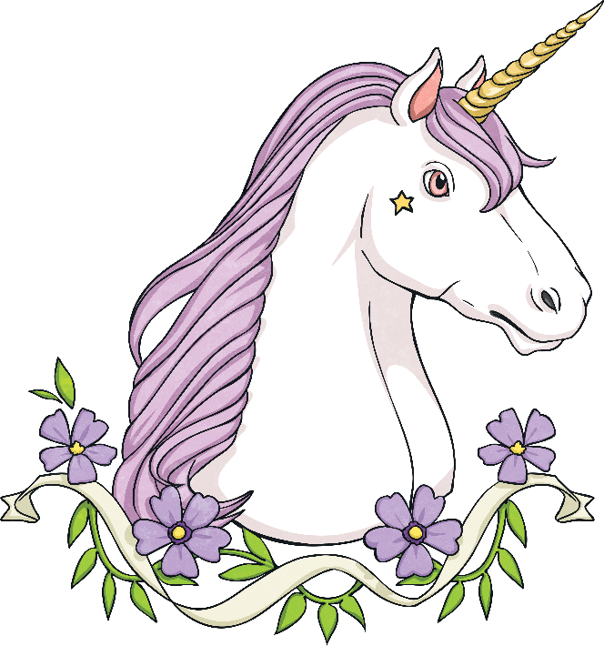
Compare Numbers to 1000
Deepest
Wizard Wally wants to find the box with the smallest number of unicorn hairs in.
864
837
752
685
Explain to your partner how he can use what he knows about place value to identify which number is the smallest.

Slide 10
Compare Numbers to 1000
Deepest
I’m thinking of a number. It has 3 digits. It is smaller than 640 but greater than 600. It has a digit sum of 14.
What number could it be?
617, 626, 635

Slide 11
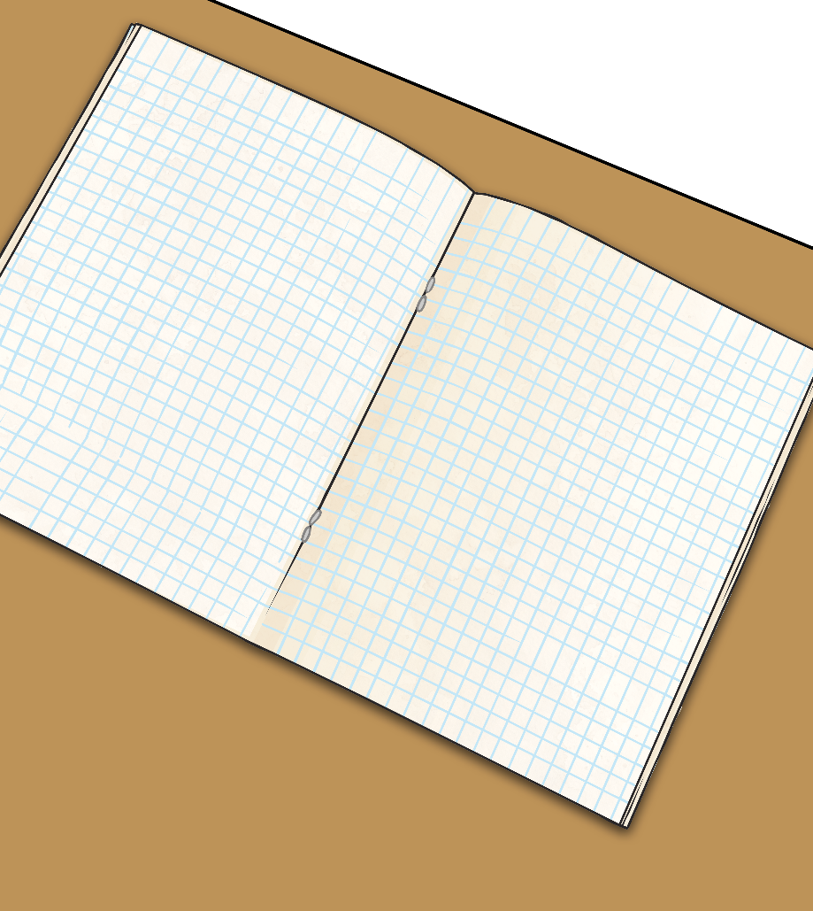
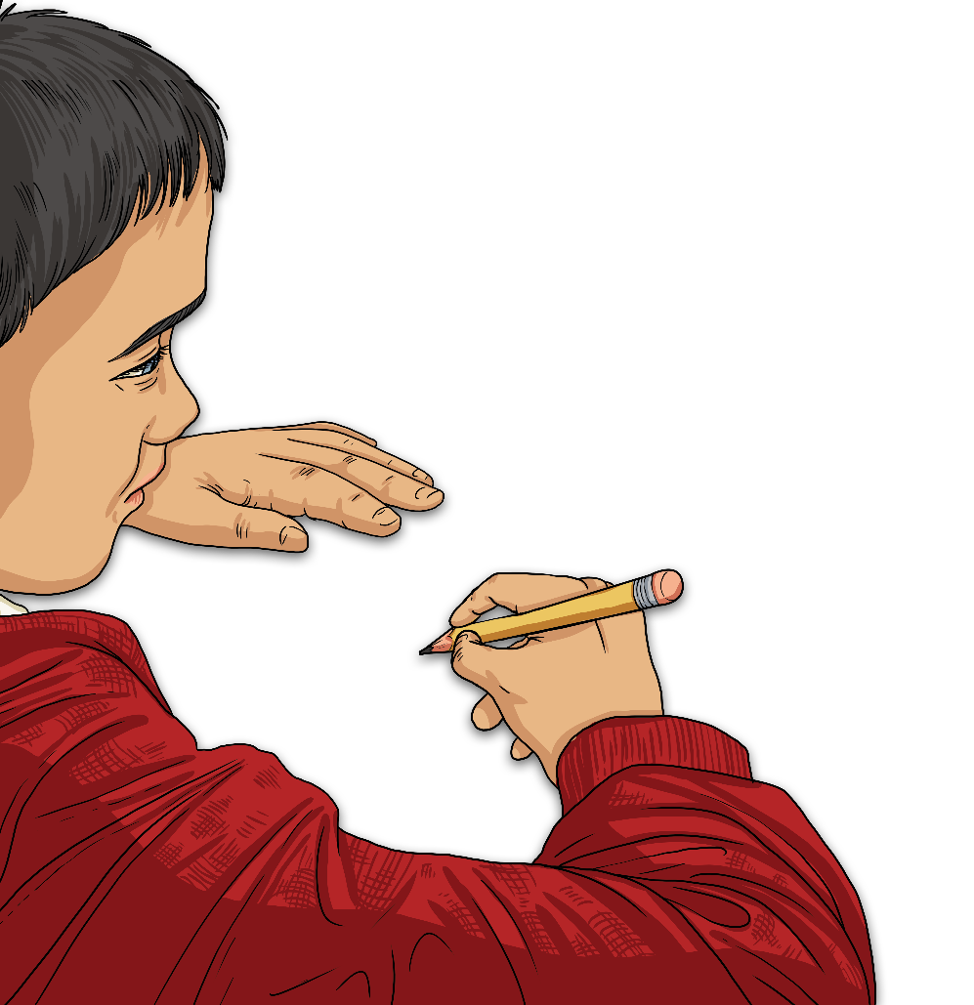
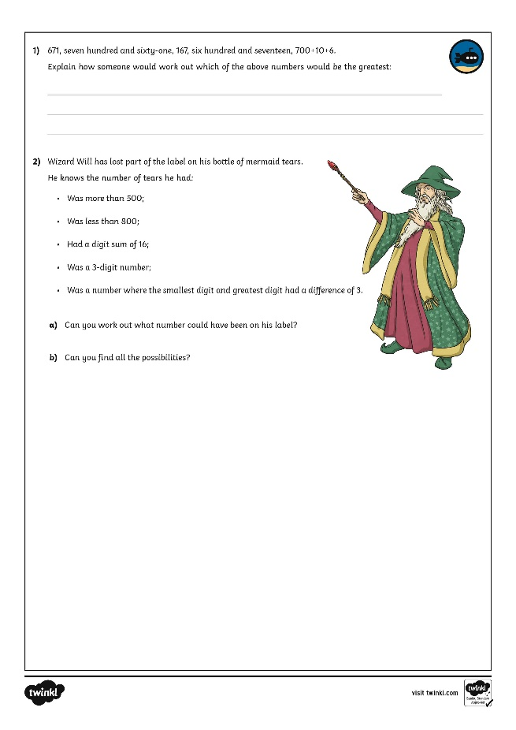
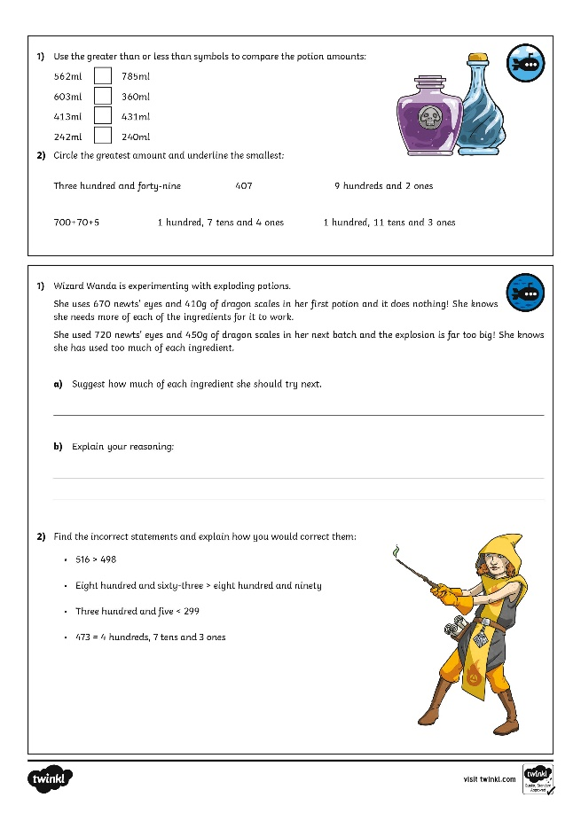
Compare Numbers to 1000
Dive in by completing your own activity!

Slide 12
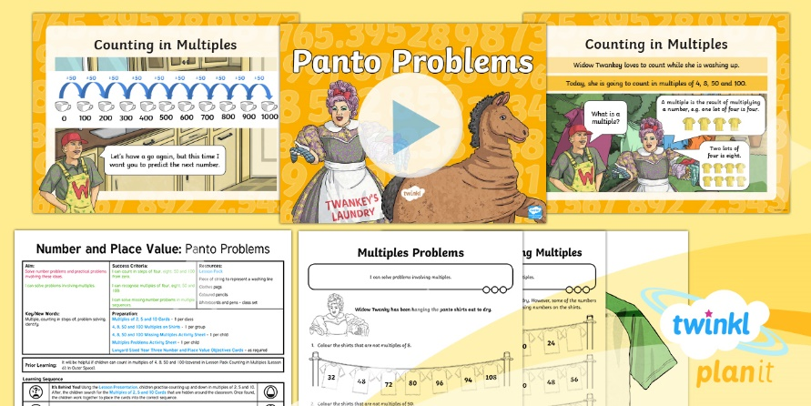
Need Planning to Complement this Resource?
National Curriculum Aim
Solve number problems and practical problems involving these ideas.
For more planning resources to support this aim, click here.
Twinkl PlanIt is our award-winning scheme of work with over 4000 resources.

